Slide 1
BUSINESS COMMUNICATION
Topic: Using data mining to determine which area is most affected by Corona virus(COVID-19)
Section: Q

Slide 2
Presented By
HASAN, NAZMUL
ID:18-37377-1

Slide 3
Introduction
Covid-19
“Corona virus disease (COVID-19) is an infectious disease caused by a newly discovered corona virus”
-World Health Organization
Data mining
“Data mining is a process of discovering patterns in large data sets involving methods at the intersection of machine learning, statistics, and database systems”
-Wikipedia

Slide 4
Why Data Mining Approach?
Not be easy for a computer data analyst or detective to identify these patterns by simple querying.
Deal with enormous amounts of data and dealing with noisy or missing data about the affected area incidents

Slide 5
Data mining involves six common classes of tasks
Anomaly detection.
Association rule learning.
Clustering.
Classification.
Regression.
Summarization.

Slide 6
Using Clustering Techniques to Identify Patterns
K-Means Cluster
Task of identifying groups of records that are similar between themselves.
Clusters will useful for identifying a crime spree committed by one or same group of suspects.

Slide 7
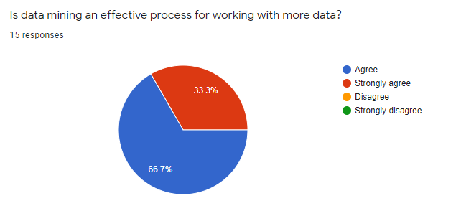
Survey

Slide 8
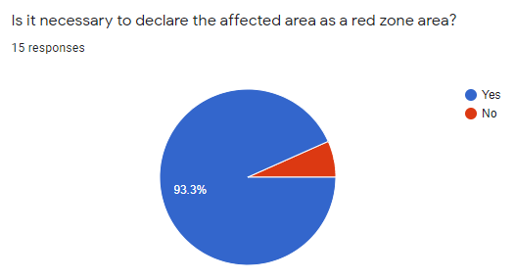
Survey

Slide 9
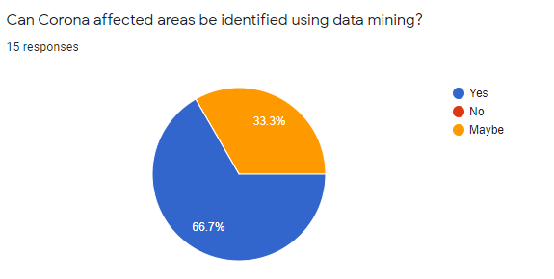
Survey

Slide 10
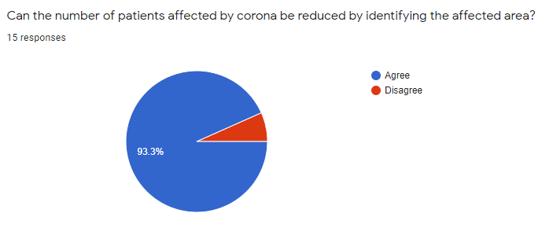
Survey

Slide 11
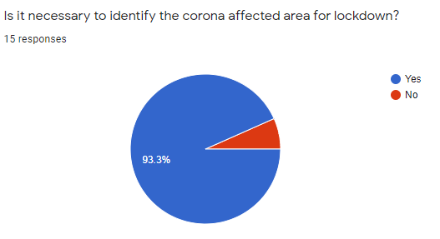
Survey

Slide 12
Conclusion

Slide 13
Any Questions??
THANK YOU

